Slide 1


List of Peer Institutions for Benchmarking
Institutional Research and Planning Office
Dr. Antonio A. González, Director
Dr. David González, Institutional Research Coordinator
Dr. Sandra Dika, Institutional Researcher
Mrs. Sheila Marty, Statistician

Slide 2
Why we should identify peer institutions?
To measure and compare with them
  Present execution
  Ideal or aspirational execution
To assist management with decision making
  Institutional Indicators/Strategies
  “Dashboard”(example, University of Miami)
  Strategic Planning
  Continuous Improvement

Slide 3
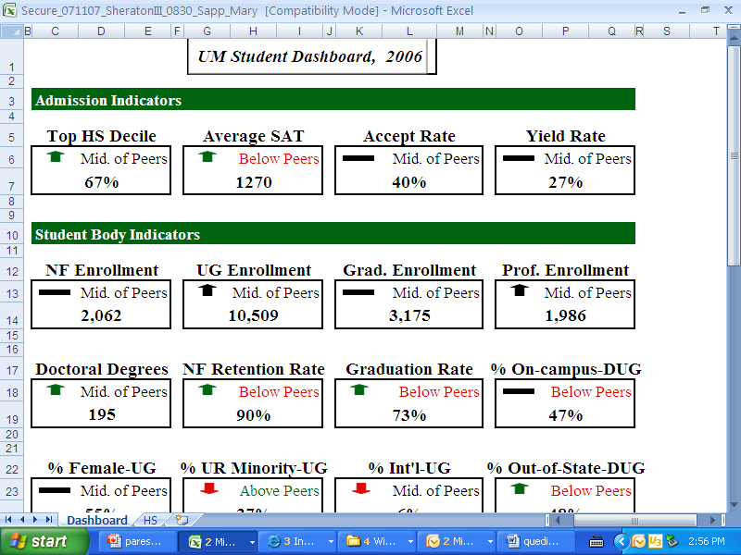
“Dashboard” Example

Slide 4
PEDS Peer Analysis System (PAS)
  Select variables from 7 categories:
    Institutional characteristics
    Enrollment
    Degrees Conferred
    Graduation Rate
    Financial Aid
    Finances
    Human Resources

Slide 5
Institutional characteristics
Carnegie Clasification:
  Size and setting
  Enrollment profile
  Undergraduate profile (selectivity and transfer rate)
  Undergraduate instructional program
  Graduate instructional program
Result: 18 peer institutions were selected

Slide 6
18 Comparable Institutions
Institution | Percent first-time full-time students receiving financial aid | Carnegie classification: Undergraduate Instructional Program (prog offerings) | Carnegie classification: Graduate Instructional Program (prog offerings) | Carnegie classification: Undergraduate Profile (selectivity and transfer rate) | Carnegie classification: Enrollment Profile (undergrad vs grad) | Carnegie classification: Size and Setting (size and residentiality) | Graduation Rate (150% time) | Full-time enrollment
Boise State University | 34 | Professions plus arts & sciences, some graduate coexistence | Single doctoral (education) | Medium full-time four-year, selective, higher transfer-in | Very high undergraduate (less than 10% grad/prof) | Large four-year, primarily nonresidential | 32 | 11173
California Polytechnic State University-San Luis Obispo | 12 | Professions plus arts & sciences, some graduate coexistence | Postbaccalaureate comprehensive | Full-time four-year, more selective, higher transfer-in | Very high undergraduate (less than 10% grad/prof) | Large four-year, primarily nonresidential | 69 | 17226
California State Polytechnic University-Pomona | 30 | Professions plus arts & sciences, some graduate coexistence | Postbaccalaureate comprehensive | Full-time four-year, selective, higher transfer-in | Very high undergraduate (less than 10% grad/prof) | Large four-year, primarily nonresidential | 46 | 15568
CUNY Bernard M Baruch College | 53 | Professions plus arts & sciences, some graduate coexistence | Postbaccalaureate comprehensive | Medium full-time four-year, selective, higher transfer-in | High undergraduate (10-24% grad/prof) | Large four-year, primarily nonresidential | 65 | 10582
Georgia Southern University | 25 | Professions plus arts & sciences, some graduate coexistence | Single doctoral (education) | Full-time four-year, selective, higher transfer-in | Very high undergraduate (less than 10% grad/prof) | Large four-year, primarily nonresidential | 41 | 13735
Idaho State University | 43 | Professions plus arts & sciences, some graduate coexistence | Comprehensive doctoral (no medical/veterinary) | Medium full-time four-year, selective, higher transfer-in | High undergraduate (10-24% grad/prof) | Large four-year, primarily nonresidential | 23 | 8818
Kennesaw State University | 19 | Professions plus arts & sciences, some graduate coexistence | Postbaccalaureate comprehensive | Medium full-time four-year, selective, higher transfer-in | Very high undergraduate (less than 10% grad/prof) | Large four-year, primarily nonresidential | 32 | 11964

Slide 7
18 Comparable Institutions
Institution | Percent first-time full-time students receiving financial aid | Carnegie classification: Undergraduate Instructional Program (prog offerings) | Carnegie classification: Graduate Instructional Program (prog offerings) | Carnegie classification: Undergraduate Profile (selectivity and transfer rate) | Carnegie classification: Enrollment Profile (undergrad vs grad) | Carnegie classification: Size and Setting (size and residentiality) | Graduation Rate (150% time) | Full-time enrollment
Missouri State University | 30 | Professions plus arts & sciences, some graduate coexistence | Postbaccalaureate comprehensive | Full-time four-year, selective, higher transfer-in | High undergraduate (10-24% grad/prof) | Large four-year, primarily nonresidential | 50 | 13758
Southeastern Louisiana University | 35 | Professions plus arts & sciences, some graduate coexistence | Postbaccalaureate comprehensive | Full-time four-year, selective, higher transfer-in | Very high undergraduate (less than 10% grad/prof) | Large four-year, primarily nonresidential | 26 | 12090
Texas Southern University | 78 | Professions plus arts & sciences, some graduate coexistence | STEM dominant | Full-time four-year inclusive | High undergraduate (10-24% grad/prof) | Large four-year, primarily nonresidential | 16 | 9033
University of Central Oklahoma | 31 | Professions plus arts & sciences, some graduate coexistence | Postbaccalaureate comprehensive | Medium full-time four-year, selective, higher transfer-in | Very high undergraduate (less than 10% grad/prof) | Large four-year, primarily nonresidential | 35 | 10609
University of Louisiana at Lafayette | 33 | Professions plus arts & sciences, some graduate coexistence | STEM dominant | Full-time four-year, selective, higher transfer-in | Very high undergraduate (less than 10% grad/prof) | Large four-year, primarily nonresidential | 39 | 13780
University of Nebraska at Omaha | 32 | Professions plus arts & sciences, some graduate coexistence | Doctoral, professional dominant | Medium full-time four-year, selective, higher transfer-in | High undergraduate (10-24% grad/prof) | Large four-year, primarily nonresidential | 38 | 9201
University of Puerto Rico-Mayagüez | 71 | Professions plus arts & sciences, some graduate coexistence | STEM dominant | Full-time four-year, more selective, lower transfer-in | Very high undergraduate (less than 10% grad/prof) | Large four-year, primarily nonresidential | 54 | 11132
University of South Alabama | 29 | Professions plus arts & sciences, some graduate coexistence | Doctoral, professional dominant | Medium full-time four-year, selective, higher transfer-in | High undergraduate (10-24% grad/prof) | Large four-year, primarily nonresidential | 33 | 9635
Notes:
7

Slide 8
18 Comparable Institutions
Institution | Percent first-time full-time students receiving financial aid | Carnegie classification: Undergraduate Instructional Program (prog offerings) | Carnegie classification: Graduate Instructional Program (prog offerings) | Carnegie classification: Undergraduate Profile (selectivity and transfer rate) | Carnegie classification: Enrollment Profile (undergrad vs grad) | Carnegie classification: Size and Setting (size and residentiality) | Graduation Rate (150% time) | Full-time enrollment
Weber State University | 22 | Professions plus arts & sciences, some graduate coexistence | Postbaccalaureate professional (business dominant) | Higher part-time four-year | Very high undergraduate (less than 10% grad/prof) | Large four-year, primarily nonresidential | 38 | 10348
Western Michigan University | 19 | Professions plus arts & sciences, some graduate coexistence | Comprehensive doctoral (no medical/veterinary) | Full-time four-year, selective, higher transfer-in | High undergraduate (10-24% grad/prof) | Large four-year, primarily nonresidential | 54 | 19725
Wright State University-Main Campus | 33 | Professions plus arts & sciences, some graduate coexistence | Doctoral, professional dominant | Full-time four-year, selective, higher transfer-in | High undergraduate (10-24% grad/prof) | Large four-year, primarily nonresidential | 41 | 12705
Youngstown State University | 42 | Professions plus arts & sciences, some graduate coexistence | Single doctoral (education) | Full-time four-year inclusive | Very high undergraduate (less than 10% grad/prof) | Large four-year, primarily nonresidential | 37 | 9631
Notes:
8

Slide 9
Cluster Analysis
Application of statistical method to identify groups with similar characteristics
As a result, UPRM became part of a cluster of eleven universities out of the eighteen originally presented in the previous table

Slide 10
Our recommended eleven peer institutions
Boise State University
California Polytechnic State University- San Luis Obispo
California Polytechnic State University- Pomona
Georgia Southern University
Kennesee State University
Southeastern Louisiana University
Texas Southern University
University of Central Oklahoma
University of Louisiana at Lafayette
Weber State University
Youngstown State University

Slide 11
Other Factors for future peer analysis
“Land Grant Colleges & Universities”
Hispanic Percentage
Financial Aid Percentage
Graduation Rates
Programs Profiles (example, biggest program/college)
Professor/Student ratio
Others

